Slide 1
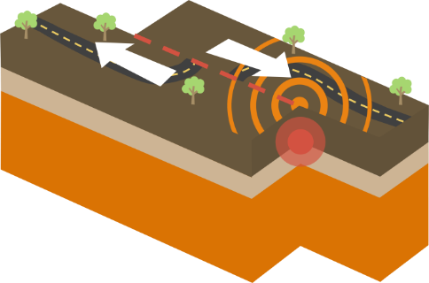
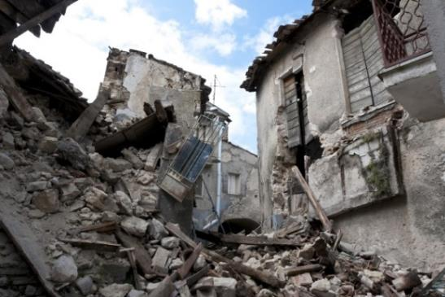
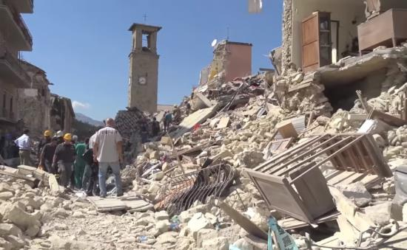
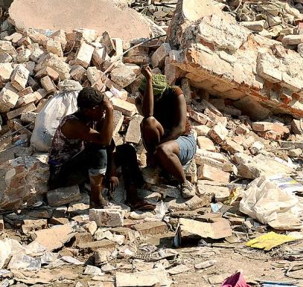
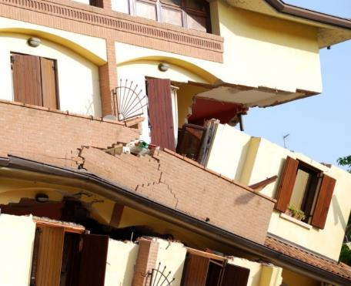
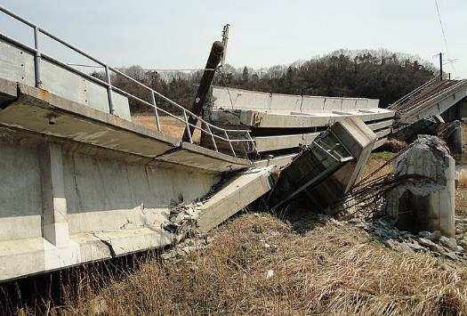

Slide 2
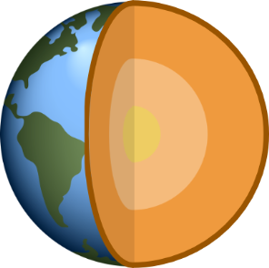
Crust
Mantle
NATURAL HAZARDS
Outer core
Inner core
Notes:
Earthquakes are natural vibrations caused by sudden movements in the Earth’s crust, the Earth’s thin outer layer.
Earthquakes are a type of natural hazard.
Q: Can anyone explain what a natural hazard is? A: Natural hazards are natural events that cause damage to property (like houses and farms) people and the environment. Other natural hazards are things like volcanoes, tsunamis, tornadoes, hurricanes and floods.
Earthquakes are natural hazards because the shaking of the Earth’s surface can cause city buildings to collapse and injuring and sometimes killing thousands of people.
Geologists study earthquakes to understand where they might happen and how people can be prepared and protected when an earthquake strikes.
National Geographic montage of earthquakes https://video.nationalgeographic.com/video/earthquake-montage

Slide 3
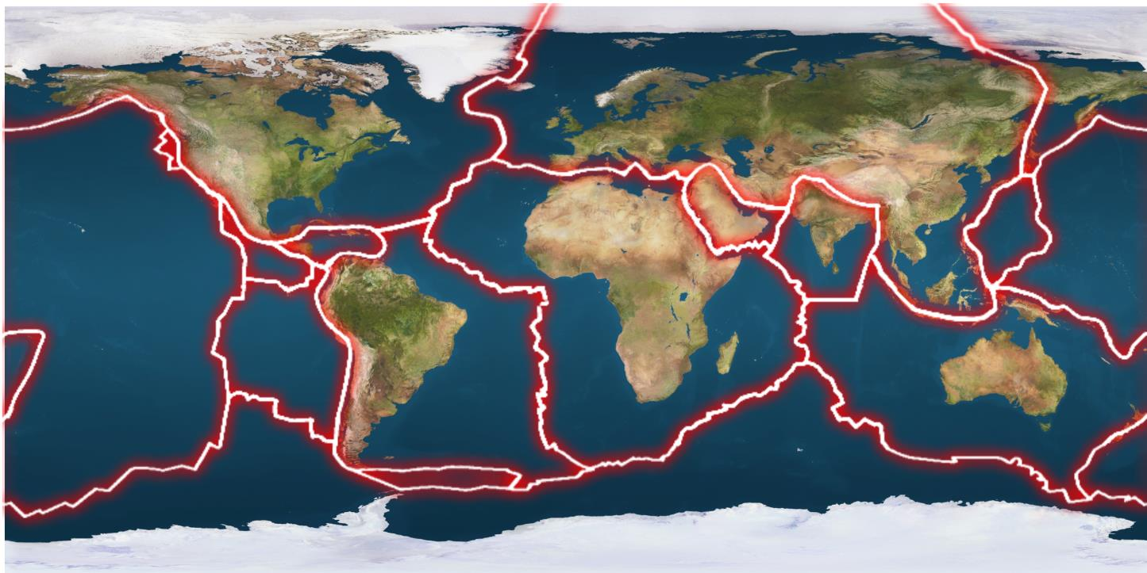
Plate boundaries
Plates
Eurasian plate
Caribbean plate
Nazca plate
Antarctic plate
Indian plate
North American plate
South American plate
Australian plate
Arabian plate
Pacific plate
African plate
Notes:
The Earth’s crust and upper parts of the mantle make up a thin skin on the surface of the Earth. This skin is not all in one piece but is broken up into huge slabs a bit like a giant jigsaw puzzle (point out different parts). These puzzle pieces are called tectonic plates and the edges of the plates are called plate boundaries. The plates move around on the surface of the Earth. You can’t feel the plates moving around because they move really slowly at about the same speed as your fingernails grow!
The red lines on the map show the boundaries between the different tectonic plates.
Get students to try to name some of the plates
Click next slide to show plate names

Slide 4
Eurasian plate
North American plate
Arabian plate
Caribbean plate
Pacific plate
Indian plate
African plate
Nazca plate
Australian plate
South American plate
Antarctic plate
Notes:
Here we can see all of the major tectonic plates.

Slide 5
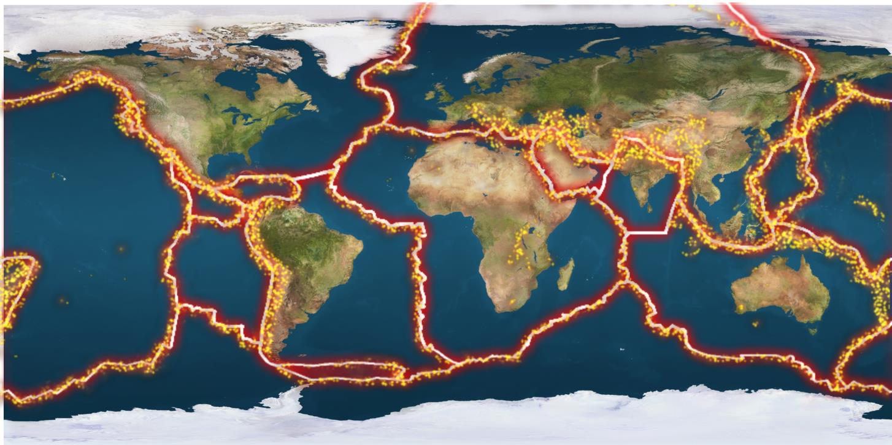
Notes:
This is the same map but it has had yellow dots added to it.
Q: What do you think the yellow dots are showing? A: Yellow dots are showing the location of major earthquakes on Earth.
Q: What do you notice about where the yellow dots are? A: they are almost always near a plate boundary
Almost all earthquakes that happen on Earth happen in the zones between two or more different plates which are called plate boundaries (point out a few plate boundaries with earthquakes).

Slide 6
Identify the countries experience a large number of earthquakes and volcanic eruptions?
Why doesn't Australia experience many large earthquakes compared to some other countries?
Describe how the pattern of earthquakes relates to plate boundaries, as shown on the map.

Slide 7
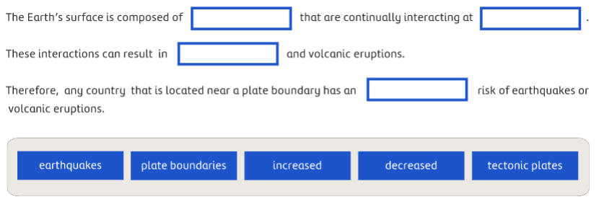
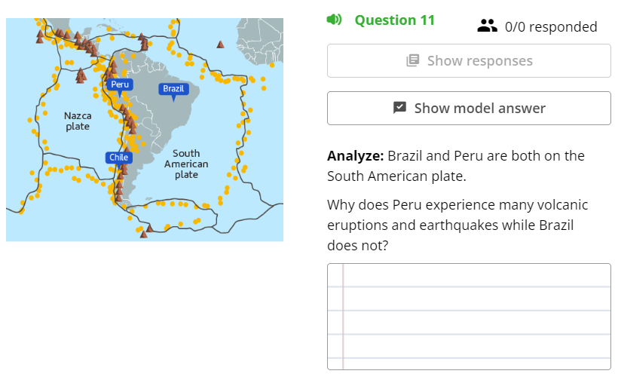
WHERE TO PUT?

Slide 8
WHAT WE ALREADY KNOW

Slide 9
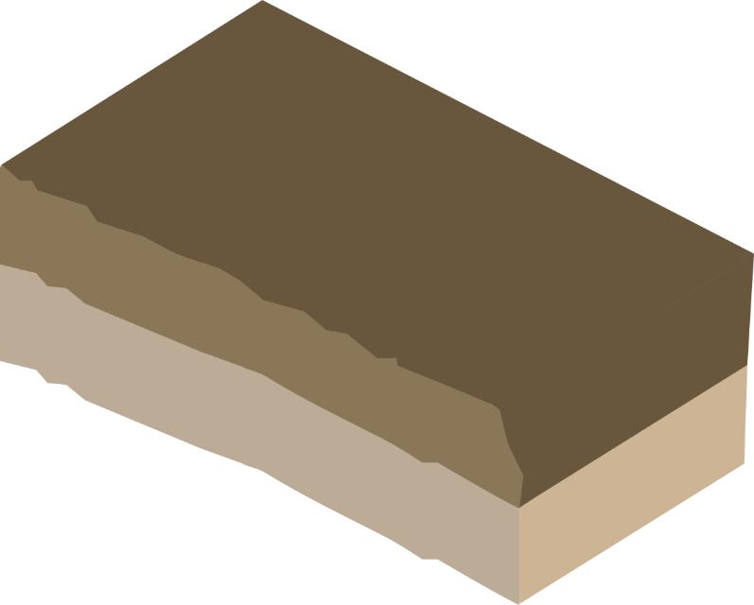
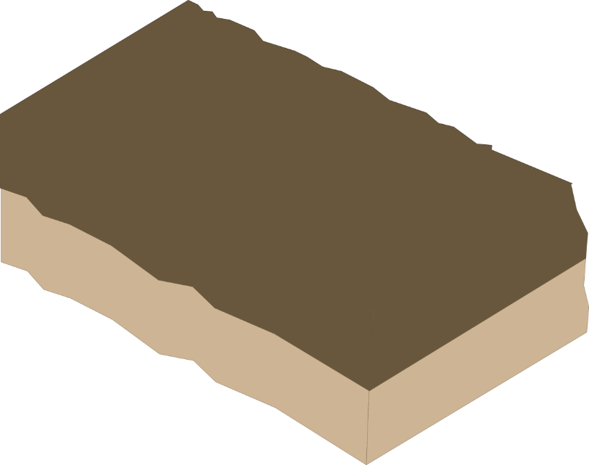
Lots of friction!
Notes:
The edges of tectonic plates are jagged and rough. This means that when they push and grind past each other, at plate boundaries they generate lots of friction.

Slide 10
Stress
Notes:
Sometimes blocks of rock can become locked together. When this happens, the plates get stuck together the energy that would normally cause the blocks to move past each other is stored up.

Slide 11
Notes:
Eventually the stress builds up so much that the plates suddenly jolt into a new position. This movement releases vibrations called seismic waves which travel through the Earth, shaking the surface, including anything on it. This is an earthquake!
Go through slides 6 -8 again if needed to show the earthquake happening

Slide 12
Epicentre
Focus
Notes:
The point at which the earthquake occurs below the Earth’s surface is called the focus, the point directly above the focus on the Earth’s surface is known as the epicentre.

Slide 13
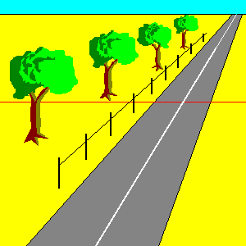
Notes:
this is an exaggerated model of what happens

Slide 14
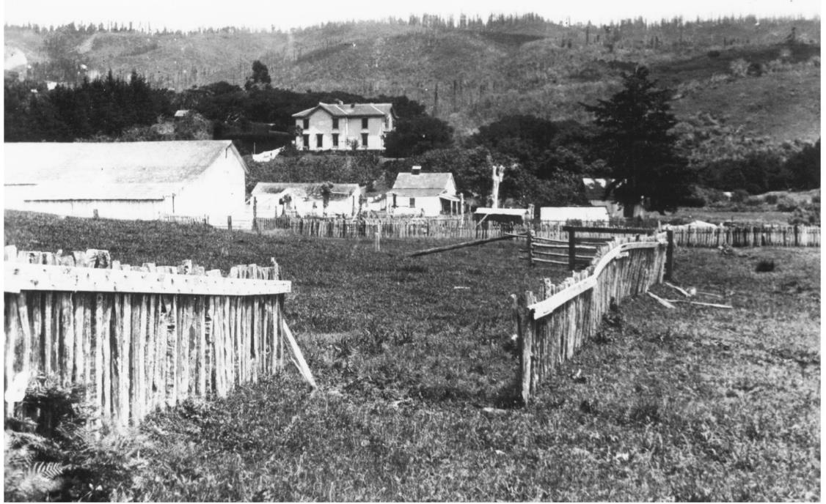
Displacement produced during the 1906 San Francisco earthquake

Slide 15
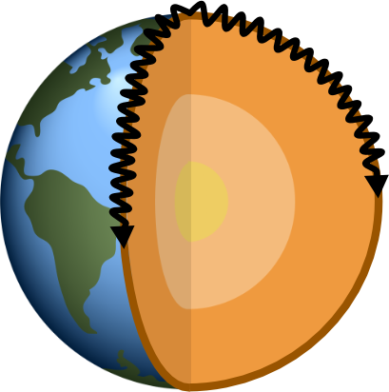
Earthquake
Surface Waves
Notes:
When an earthquake happens it releases vibrations which travel outward from the focus in every direction. When these vibrations reach the surface, they cause the ground to shake.
The vibrations travel as waves of energy known as seismic waves. Geologists measure these seismic waves at different stations around the Earth to work out where an earthquake has occurred.
There are three main types of seismic wave. The first type are known as surface waves. They travel through the Earth’s crust away from the focus in all directions. They move from side to side and up and down – surface waves cause most damage to buildings in an earthquake.
Click to show building damage

Slide 16
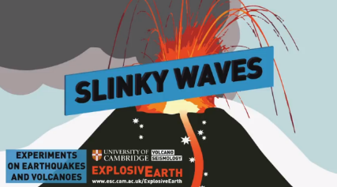
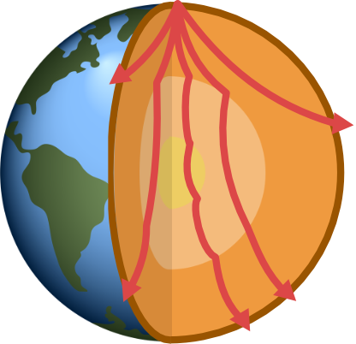
Primary (P) WAVES
Earthquake
P waves travel through the whole Earth including the core
They travel through the Earth by pushing and pulling rocks in the direction they are travelling
P Waves
Notes:
The second type of seismic wave released from an earthquake is called a P wave. P waves travel through the whole Earth including the core. They travel through the Earth by pushing and pulling rocks in the direction they are travelling.
Demonstrate with a slinky OR watch the first part of this YouTube video (https://www.youtube.com/watch?v=v2xhHRQkbNg)
Get two students to hold either end of a slinky (metal ones are best). To demonstrate a P- wave one student needs to push the end of the slinky towards the other student.

Slide 17
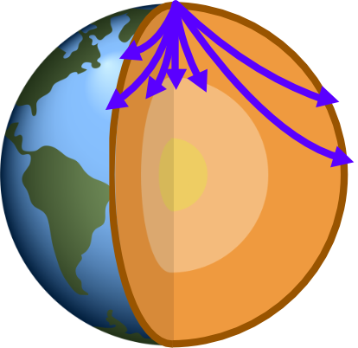
Secondary (S) WAVES
Earthquake
These waves from side to side as they go forward.
S waves can’t travel through liquid so they can’t travel through the Earths outer core which is made from liquid metal.
S Waves
Notes:
The third type of seismic wave is called an S wave, these waves from side to side as they go forward. S waves can’t travel through liquid so they can’t travel through the Earths outer core which is made from liquid metal.
Demonstrate with a slinky OR watch the second part of this YouTube video (https://www.youtube.com/watch?v=v2xhHRQkbNg)
Get two students to hold either end of a slinky (metal ones are best). To demonstrate an S wave one student move the slinky from side to side horizontally.

Slide 18
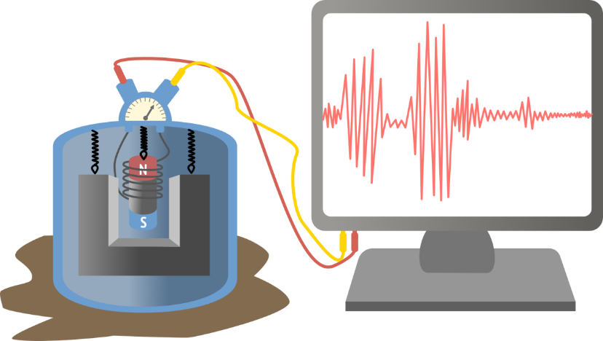
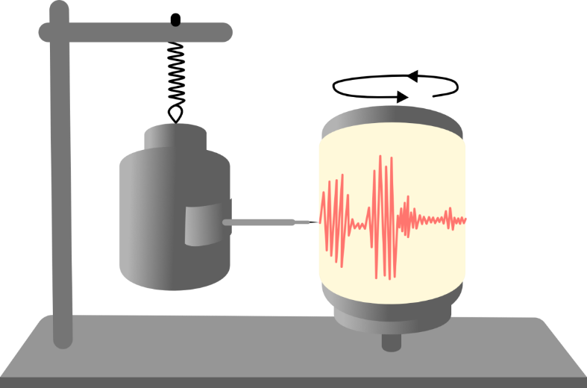
Old fashioned seismograph
Modern seismograph
Seismographs are instruments used to record the motion of the ground during an earthquake
Notes:
Geologists measure seismic waves using instruments called seismographs. In the past, seismographs worked by having a pen suspended on a weight that then drew a line onto a rotating drum covered with graph paper. When the ground shook in an earthquake, the drum would go up and down and create a wiggly line on the drum. The more the ground shook the wigglier the line would be! Today geologists use seismographs which operate using a similar process but instead of pen and paper they use electromagnets which generate a voltage when there is an earthquake and this voltage is then transmitted to a computer display.
The strength or size of an earthquake is called it’s magnitude. The bigger the earthquake, the more energy released and the bigger the earthquake’s magnitude. An earthquake with a large magnitude will make the Earth’s surface shake more and usually cause more damage than a smaller magnitude earthquake.
As well as working out how big an earthquake is geologists also need to work out where an earthquake has struck. They do this by looking at the P and S seismic waves. S waves travel slower than P waves which means that the further you are away from the earthquake the more spread apart these two waves will be on your seismograph.

Slide 19
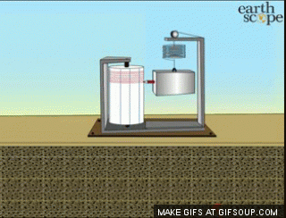

Slide 21
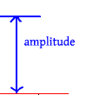
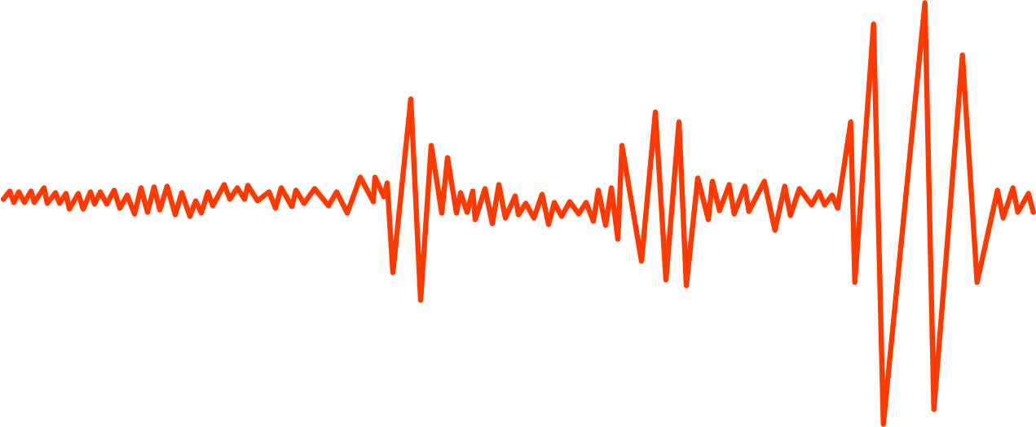
Surface waves arrive last
P waves arrive first
S waves arrive next
P - S wave time interval
Notes:
As well as working out how big an earthquake is, geologists also need to work out where an earthquake has struck. They do this by looking at the P and S seismic waves. S waves travel slower than P waves which means that the further you are away from the earthquake the more spread apart these two waves will be on your seismograph.

Slide 22
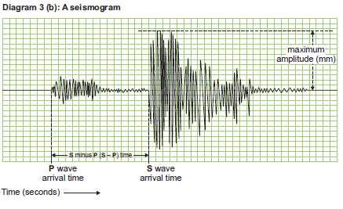

Slide 23
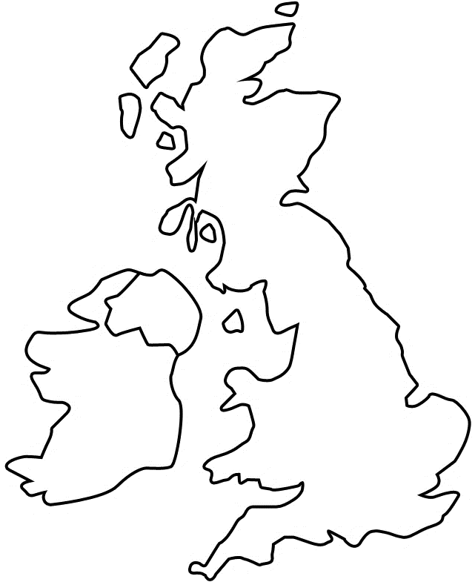
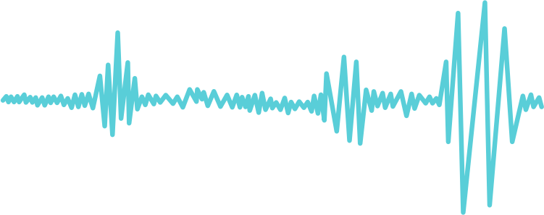
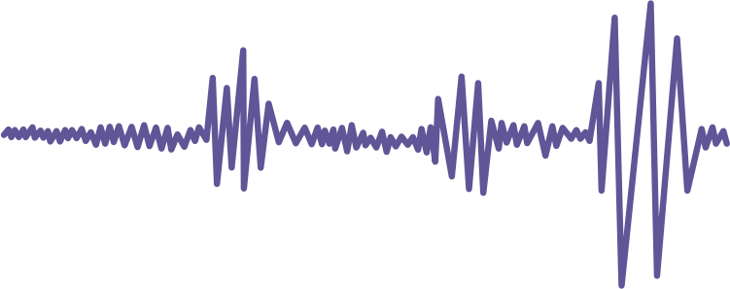
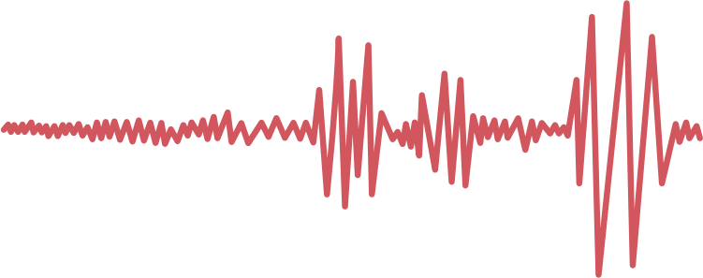
P
S
P
S
1
2
P
S
3
Notes:
Imagine an earthquake has happened in the UK – stations around the country are set up to measure seismic waves. From the seismographs, the distance from the earthquake to the recording station is calculated by the time difference between the P and S waves.
Click for Station 1
Station 1 in Newcastle detected seismic waves on their seismograph – they used the difference in time between the P and S waves to work out that an earthquake occurred 200km away but they do not know in which direction. The earthquake could have occurred at any point on the blue line so we haven’t really narrowed it down very much!
Click for Station 2
Station 2 in Belfast detected seismic waves on their seismograph too – the P and S waves they detected were slightly closer together than those detected in Newcastle. They worked out that an earthquake occurred 125km away from them. We now have two cross overs one in west Scotland and one in North Wales so we have 2 possible locations for our earthquake.
Click for Station 3
Station 3 in Cardiff also detected seismic waves. The P and S waves they detected were even closer together so the earthquake must have been closest to Cardiff out of the three cities. We now only have one spot which overlaps each of the circles so this is where the earthquake must have happened!

Slide 24
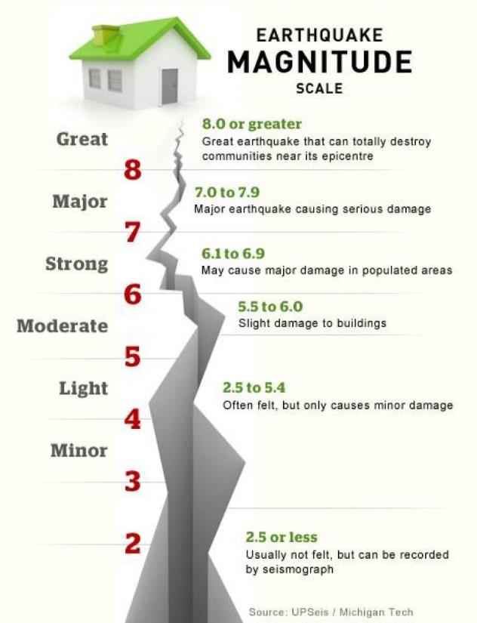
THE RICHTER SCALE
Magnitude scales
Richter magnitude - concept introduced by Charles Richter in 1935
Richter scale
Based on the amplitude of the largest seismic wave recorded
Accounts for the decrease in wave amplitude with increased distance

Slide 25
THE RICHTER SCALE

Slide 26
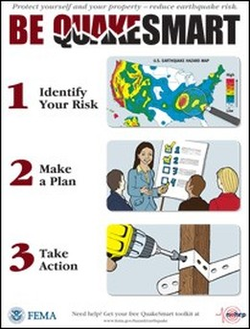
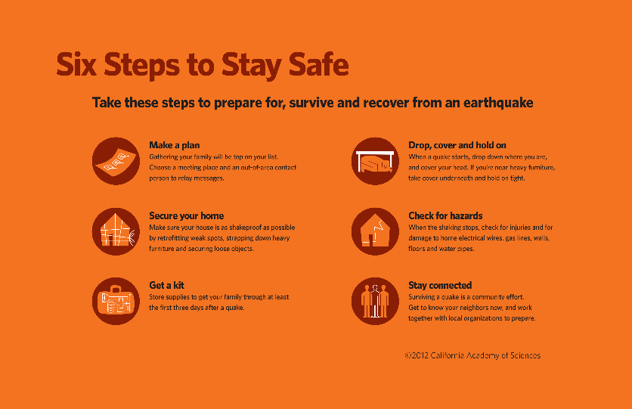
EARTHQUAKE PREPARATION
Identifying hazards
Detection technology
Building safer structures
Providing education on earthquake safety

Slide 27
Computer controlled weights on roof
Cross bracing – allows building to twist
Open areas for evacuation
Fire resistant building materials
Automatic shutters
Foundations sunk into solid rock
Road – quick access for emergency services
Rubber shock absorbers
Notes:
Geologists know where earthquakes are likely to happen but it is impossible to predict when an earthquake will occur. It is important for earthquake-prone countries such as Japan to be prepared at all times.
Engineering buildings to withstand earthquakes is extremely important in built up cities such as Tokyo in Japan.
Engineering that allows buildings to ‘wobble’ instead of remaining still in an earthquake can help stop buildings collapsing and potentially save thousands of lives during a large earthquake. Other useful ways to stop building collapsing is to install computer controlled weights on the roof, build form fire resistant materials, install automatic shutters which prevent the windows for shattering and injuring people during an earthquake, make sure buildings have good road access and open areas for people to evacuate safely.
Buildings can either be designed and build as earthquake resistant or they can be retrofitted – this means that new technologies can be applied to older buildings to help make them more resistant to earthquakes.
Educating the public is also very important so that people know what to do if they feel an earthquake. Generally staying indoors under a sturdy table or doorframe is the safest thing to do.

Slide 28
Earthquake Resistance Building Engineering Challenge
Stile Lesson:
3.6 Engineering challenge: Earthquake-resistant building

Slide 29
Design brief
You are to design a building that would withstand a major earthquake. You will need to design, build and test a small scale model that meets the following criteria:
is quick and easy to assemble
has a minimum height of 60 cm
has a maximum base of 30 cm x 30 cm
remains standing after an earthquake, as simulated by shaking a table for 10 seconds
is constructed from the materials supplied by your teacher
costs less than $60 to build, given the material costs listed below
Your model cannot be attached to the table in any way.

Slide 30
Tips to make your structure more earthquake proof:
Wide base
Solid foundation
Symmetrical design
Think about additional supports
Think about where you might put additional weight
Notes:
You will need lots of paper straws or lollipop sticks, card and masking tape.
Give students 10 minutes to create an earthquake resistant structure from their materials.
Place structure on a tray and test how earthquake resistant each groups structure is by shaking the tray back ad forwards to see whether the structure survives.
Structures with wide bases, solid foundations, symmetrical designs and cross bracing supports (two diagonal supports in an X shape) are likely to withstand the ‘earthquake’ better.

Slide 31
Week 4 Lesson 2
Finalise design, create building, shake test
Table to identify safety/preparing measures humans use for Earthquakes
Diamond 9?
Earthquakes quiz?
Case study?

Slide 32
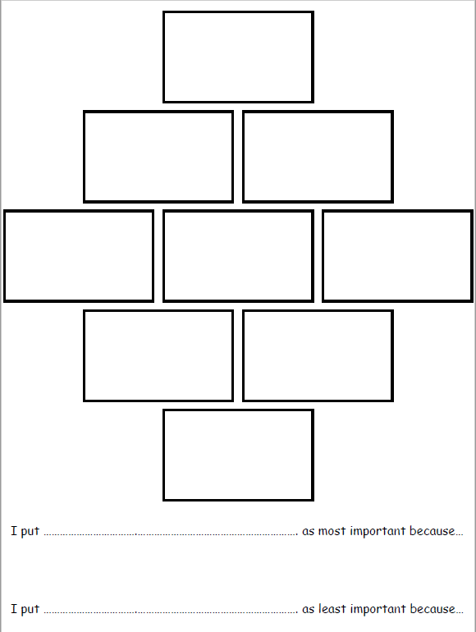
Diamond Nine
Identify what are the most important to least important strategies to use in preparation to an earthquake
Explain why you have chosen the most important and the least important

